Slide 1
Artificial Intelligence
Lecture 4, Chapter 4
Local Search Algorithm and Optimizations
SAZIA SHARMIN
Department of CS AIUB
AI

Slide 2





Table of Contents
1
Beyond Classical Search
2
Local Search Algorithms and Optimization Problems Hill-climbing search
Simulated annealing
Local beam search
Genetic algorithms
3
Local Search in Continuous Spaces
4
Exercise
5
References
AI

Slide 3
Beyond Classical Search
A single category of problems: observable, deterministic, known environments where the solution is a sequence of actions.
when these assumptions are relaxed.
Algorithms that perform purely local search in the state space, evaluating and modifying one or more current states rather than systematically exploring paths from an initial state.
These algorithms are suitable for problems in which all that matters is the solution state, not the path cost to reach it.
The family of local search algorithms includes methods inspired by statistical physics (simulated annealing) and evolutionary biology (genetic algorithms).
AI

Slide 4
Local Search Algorithms and Optimization Problems
The search algorithms that we have seen so far are designed to explore search spaces systematically.
This systematicity is achieved by keeping one or more paths in memory and by recording which alternatives have been explored at each point along the path.
When a goal is found, the path to that goal also constitutes a solution to the problem.
In many problems, however, the path to the goal is irrelevant.
AI

Slide 5
Local Search Algorithms and Optimization Problems
For example, in the 8-queens problem, what matters is the final configuration of queens, not the order in which they are added.
The same general property holds for many important applications such as integrated-circuit design, factory-floor layout, job-shop scheduling, automatic programming, telecommunications network optimization, vehicle routing, and portfolio management.
If the path to the goal does not matter, we might consider a different class of algorithms, ones that do not worry about paths at all.
Example: Local search
AI

Slide 6
Local search
Local search algorithms operate using a single current node (rather than multiple paths) and generally move only to neighbors of that node.
Typically, the paths followed by the search are not retained.
Although local search algorithms are not systematic, they have two key advantages:
they use very little memory—usually a constant amount; and they can often find reasonable solutions in large or infinite (continuous) state spaces for which systematic algorithms are unsuitable.
AI

Slide 7
Local search solves optimization problems
Local search algorithms are useful for solving pure optimization problems, in which the aim is to find the best state according to an objective function.
Many optimization problems do not fit the “standard” search model but provides an objective function as attempting to optimize, but there is no “goal test” and no “path cost” for this problem.
To understand local search, considering the state-space landscape. A landscape has both “location” (defined by the state) and “elevation” (defined by the value of the heuristic cost function or objective function).
AI

Slide 8
Optimization problems
If elevation corresponds to cost function, then the aim is to find the lowest valley—a global minimum;
if elevation corresponds to an objective function, then the aim is to find the highest peak—a global maximum. (You can convert from one to the other just by inserting a minus sign.)
Local search algorithms explore this landscape.
A complete local search algorithm always finds a goal if one exists; an optimal algorithm always finds a global minimum/maximum.
AI

Slide 9
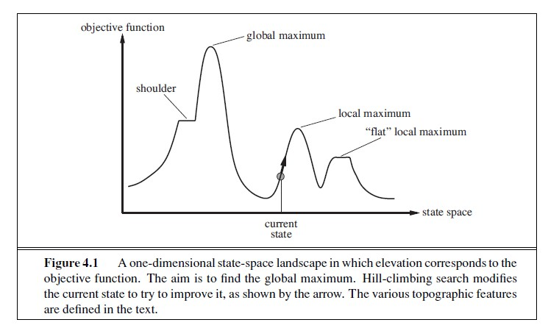
optimization problems: Hill-climbing search
AI

Slide 10
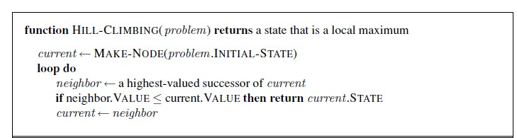
Hill-climbing Algorithm
The hill-climbing search algorithm (steepest-ascent version) is shown in Figure. It is simply a loop that continually moves in the direction of increasing value—that is, uphill.
It terminates when it reaches a “peak” where no neighbor has a higher value.
The algorithm does not maintain a search tree, so the data structure for the current node need only record the state and the value of the objective function.
Unfortunately hill climbing often gets stuck for the following reasons: Local maxima, Ridges, and Plateaux.
AI

Slide 11
Hill-climbing Cont.
Stochastic hill climbing chooses at random from among the uphill moves; the probability of selection can vary with the steepness of the uphill move.
This usually converges more slowly than the steepest ascent, but in some state landscapes, it finds better solutions.
First-choice hill climbing implements stochastic hill climbing by generating successors randomly until one is generated that is better than the current state.
This is a good strategy when a state has many (e.g., thousands) of successors.
The hill-climbing algorithms described so far are incomplete; they often fail to find a goal when one exists because they can get stuck on local maxima.
AI

Slide 12
Hill-climbing Cont.
Random-restart hill climbing adopts the well-known adage, “If at first you don’t succeed, try, try again.”
It conducts a series of hill-climbing searches from randomly generated initial states, until a goal is found.
For 8-queens, then, random-restart hill climbing is very effective indeed.
if there are few local maxima and plateaux, random-restart hill climbing will find a good solution very quickly.
NP(Nondeterministic Polynomia)-hard problems typically have an exponential number of local maxima to get stuck on.
AI

Slide 13
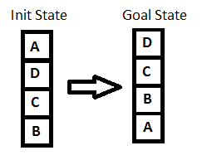
Example
Hill Climbing Algorithm can be categorized as an informed search. So we can implement any node-based search or problems like the n-queens problem using it. To understand the concept easily, we will take up a very simple example.
while solving any hill-climbing problem is to choose an appropriate heuristic function.
Let’s define such function h:
h(x) = +1 for all the blocks in the support structure if the block is correctly positioned otherwise -1 for all the blocks in the support structure.
Here, we will call any block correctly positioned if it has the same support structure as the goal state. As per the hill climbing procedure discussed earlier let’s look at all the iterations and their heuristics to reach the target state:

Slide 14
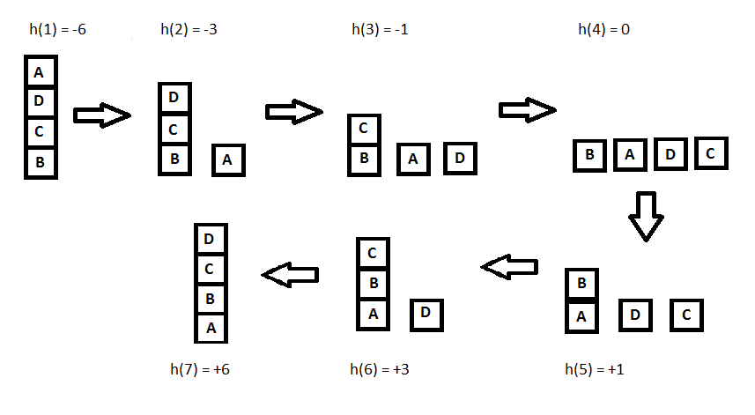

Slide 15
Simulated annealing
A hill-climbing algorithm that never makes “downhill” moves toward states with lower value.
A purely random walk that is, moving to a successor chosen uniformly at random from the set of successors—is complete but extremely inefficient.
Simulated annealing is such an algorithm to combine hill climbing with a random walk in some way that yields both efficiency and completeness.
AI

Slide 16
Local beam search
The local beam search algorithm keeps track of k states rather than just one.
Keeping just one node in memory might seem to be an extreme reaction to the problem of memory limitations.
It begins with k randomly generated states. At each step, all the successors of all k states are generated.
If any one is a goal, the algorithm halts. Otherwise, it selects the k best successors from the complete list and repeats.
A variant called stochastic beam search, instead of choosing the best k from the pool of candidate successors, stochastic beam search chooses k successors at random.
AI

Slide 17
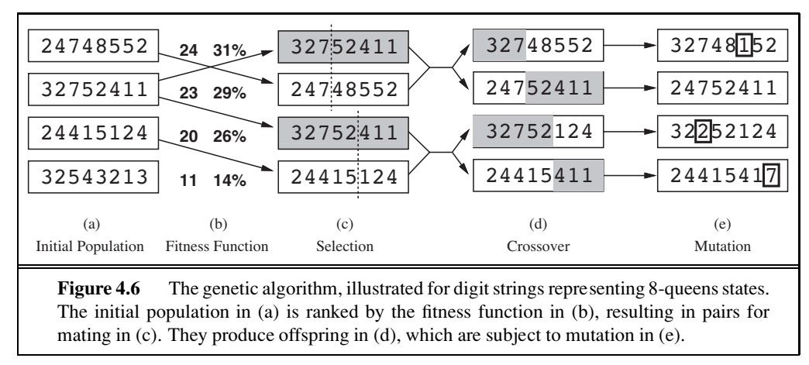
Genetic algorithms
A genetic algorithm (or GA)is a variant of stochastic beam search in which successor states are generated by combining two parent states rather than by modifying a single state.
AI

Slide 18
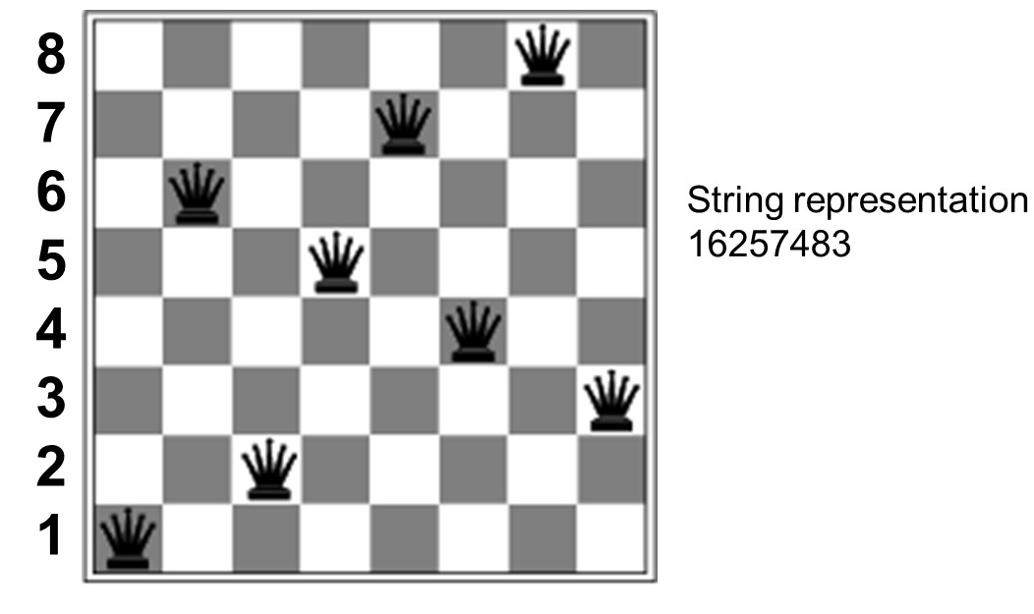
Genetic algorithms
Check every column and find the position of the queen.
AI

Slide 19
Genetic algorithms
Fitness function: evaluates how “good” a state is; number of non-attacking pairs of queens for 8-queen (min = 0, max = 8 * 7/2 = 28) . [for n-queen max attacking = n*(n-1)/2]
First state value, non attacking (total non attacking(28) - attacking(4)) = 24
2. Selection: Calculate fitness values of all individuals;
Convert fitness to selection probability.
Example: for values 24, 23, 20, 11 → total = 78
Probability of selecting state with fitness 24 = 24/78 = 31%
In (c), two pairs are selected at random for reproduction.
AI

Slide 20
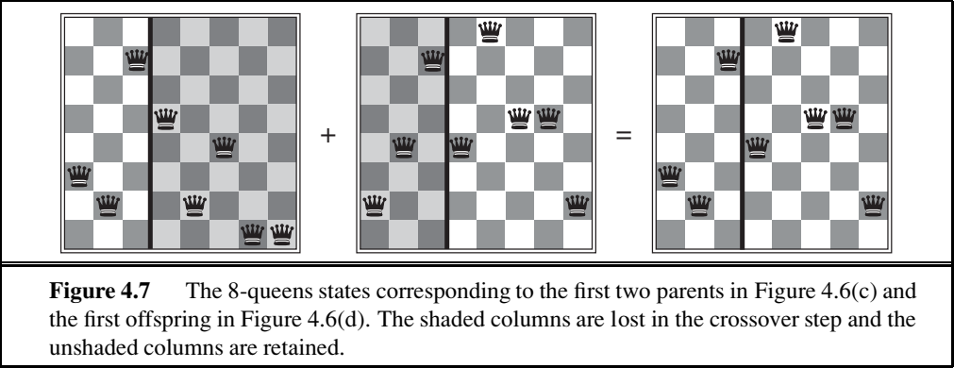
Genetic algorithms cont.
Crossover:
Combine two parents to produce a child.
One-point crossover: e.g., split after 4th gene
Parent 1: 1625|7483
Parent 2: 7381|2465
Child: 1625|2465
In the visual, shaded columns represent the discarded part, and unshaded parts are retained
AI

Slide 21
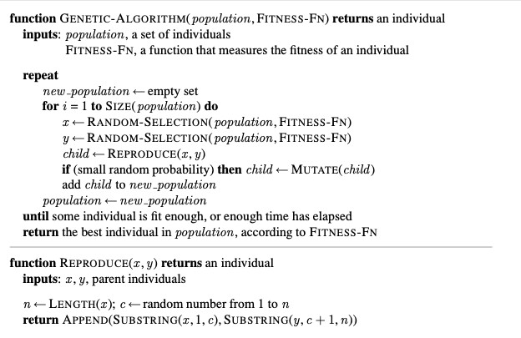
Genetic algorithms cont.
Mutation:
Randomly change a gene (queen’s row in a column) to introduce diversity and avoid local minima.
Iteration:
Repeat selection, crossover, mutation over several generations.
Stop when a chromosome with fitness = 28 is found (no attacking pairs).
AI

Slide 22
GA numerical Example
Problem : Maximize f (x ) = x ²/2 − 3x , when x in [0 to 31]
Binary Encoding – 5 digits
Initialization of Population Selection Crossover/Recombination Mutation
Survival/Accept Update Population
AI

Slide 23
References
Stuart Russell and Peter Norvig. 2009. Artificial Intelligence: A Modern Approach (3rd ed.). Prentice Hall Press, Upper Saddle River, NJ, USA.
https://www.cs.cmu.edu/ 15281/coursenotes/localsearch https://inst.eecs.berkeley.edu/ cs188/sp22/
AI

